Slide 1
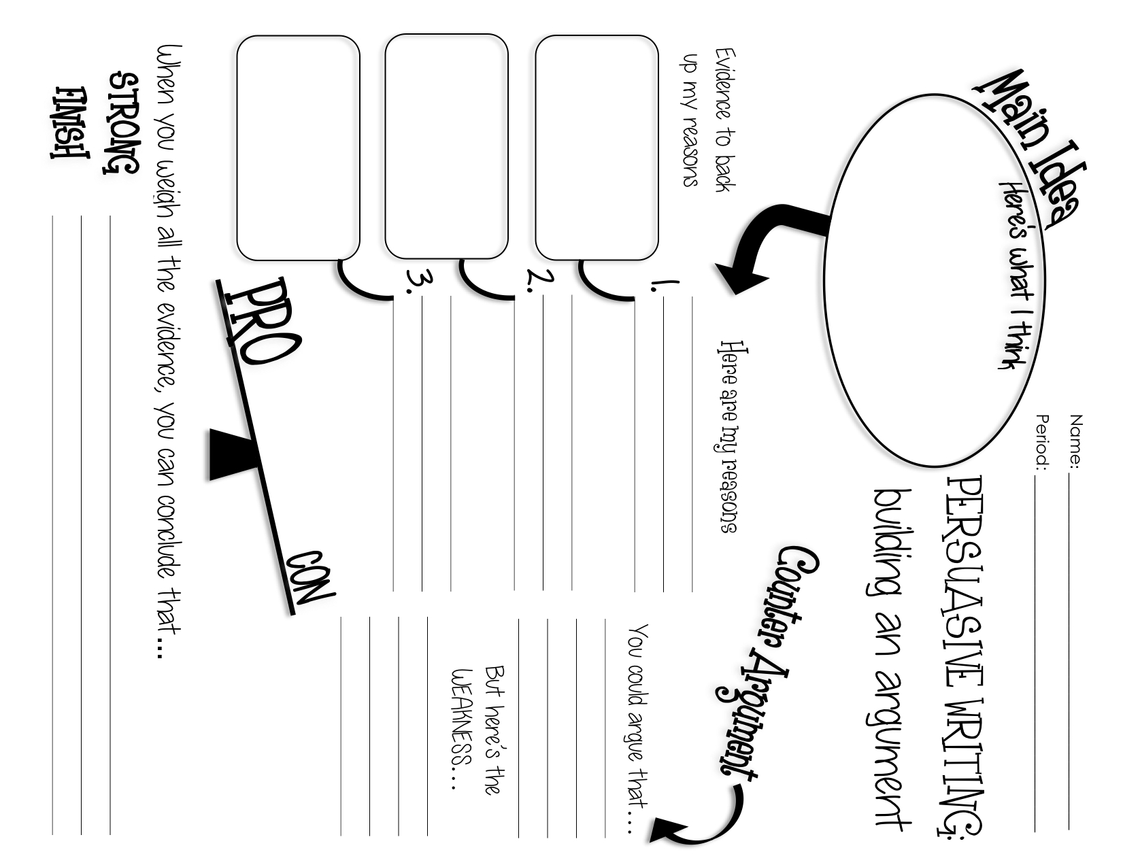

Slide 2
That’s not fair!
Write a letter to a parent/principal explaining why you think one of the rules is unfair.

Slide 3


Claim
Statement the writer is trying to prove is true
Mom, I need a car.

Slide 4
Reason
Statement supporting the claim, tells why
Because I have places to go that you cannot take me.

Slide 5
Evidence
Proof from a credible source
ACT prep is at 4 when you’re at work.

Slide 6
Explanation
Explains what the evidence proves
Since ACT prep is at 4, I’ll need a car to drive myself.

Slide 7
So What?
Why should they care
I know you want me to take ACT prep and improve my score, but I’ll need a car to do that for you.

Slide 8
Counterclaim
Statement opposing the claim, opposing argument
I know you think I could ride with friends,

Slide 9
Counterargument
Rebuttal to the counterclaim
But, none of my friends are taking ACT Prep.

Slide 10
Conclusion
Restates claim, summarizes argument
I need a car so that I can I can take ACT Prep, like you want me to.

